Slide 1

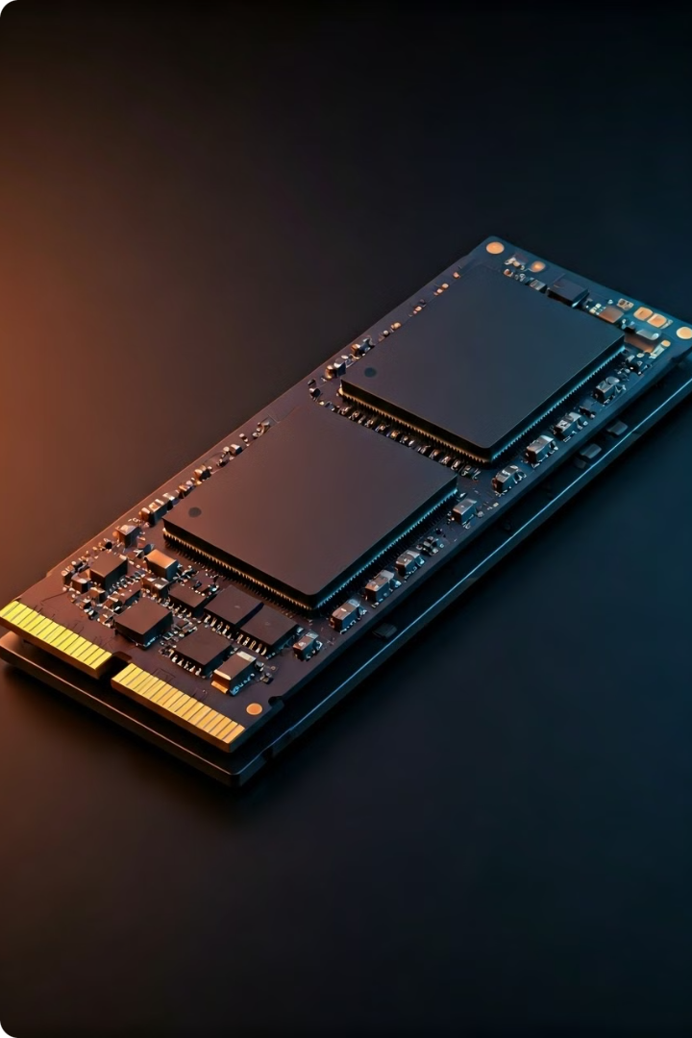

Understanding Solid State Drives (SSDs)
SSDs are a type of data storage device that uses flash memory to store data, unlike traditional hard disk drives (HDDs) which use magnetic platters. SSDs offer faster performance, lower power consumption, and increased durability compared to HDDs.
by Mohammad Javad Sharifi

Slide 2
SSD vs. HDD: The Key Differences
Data Access
Storage Capacity
Durability
SSDs use electronic circuits to access data, while HDDs rely on mechanical moving parts, leading to faster read/write speeds for SSDs.
HDDs typically offer higher storage capacities, often reaching up to several terabytes, while SSDs generally have lower maximum capacities.
SSDs are more resistant to physical shocks and vibrations due to the lack of moving parts, making them more durable than HDDs.

Slide 3

Advantages of SSDs
1
Faster Performance
SSDs offer significantly faster read and write speeds, resulting in quicker boot times, program launches, and data transfers.
2
Lower Power Consumption
SSDs use less power than HDDs, leading to longer battery life in laptops and reduced energy costs in desktop systems.
3
Increased Reliability
SSDs are more resistant to physical shocks and vibrations, reducing the risk of data loss or drive failure.
4
Quieter Operation
SSDs have no moving parts, making them completely silent during operation, unlike the whirring noise of HDDs.

Slide 4
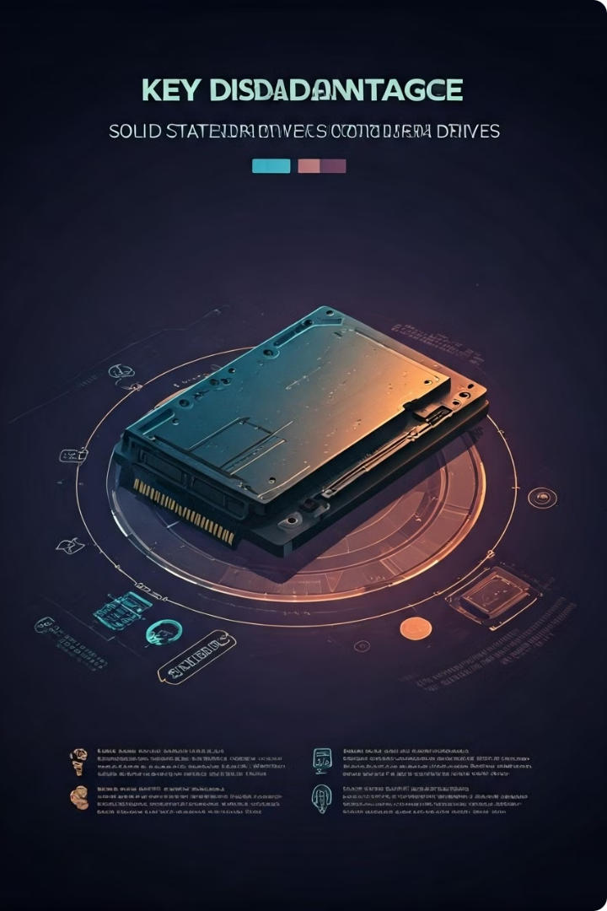
Disadvantages of SSDs
Higher Cost per Gigabyte
SSDs generally have a higher price per gigabyte of storage compared to HDDs, making them more expensive for large-capacity storage needs.
Limited Endurance
The flash memory used in SSDs has a finite number of write cycles, leading to concerns about their long-term durability for heavy-duty workloads.
Lower Total Capacity
While the capacity of SSDs is constantly increasing, they still generally offer lower maximum storage capacities compared to HDDs.

Slide 5

SSD Storage Capacity and Pricing
1
Entry-Level
SSDs with capacities ranging from 128GB to 512GB are the most affordable, making them suitable for budget-conscious users.
2
Mid-Range
SSDs with capacities from 512GB to 2TB offer a balance of storage space and performance at a moderate price point.
3
High-End
High-capacity SSDs, typically 2TB and above, provide ample storage for power users and professionals, but at a premium cost.

Slide 6
SSD Performance Characteristics
Sequential Speeds
Random Access
Latency
SSDs excel at sequential read and write speeds, allowing for faster data transfers and loading times.
SSDs demonstrate superior random access performance, which is crucial for applications that require frequent, small data transfers.
SSDs have significantly lower latency, or response times, compared to HDDs, resulting in snappier system performance.

Slide 7
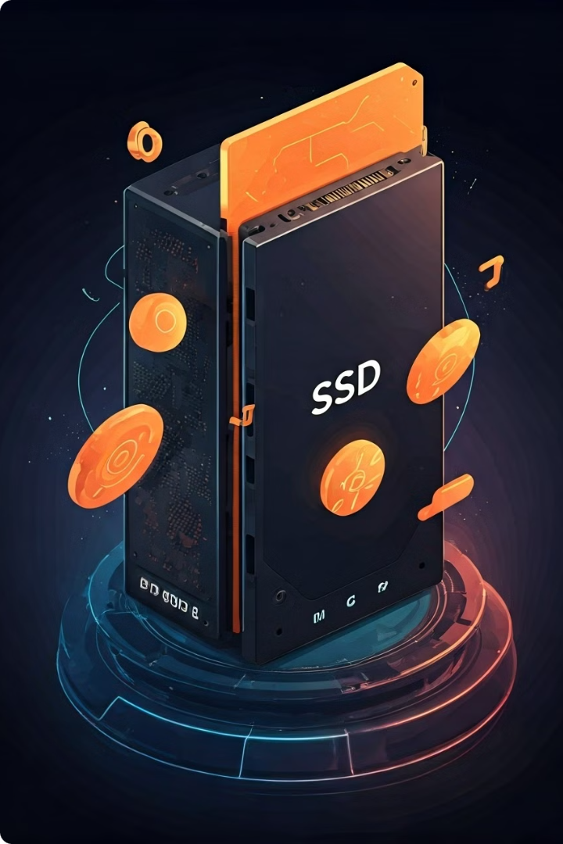



SSD Durability and Lifespan
Shock and Vibration
SSDs are more resistant to physical shocks and vibrations, reducing the risk of data loss or drive failure.
Write Endurance
While SSDs have a finite number of write cycles, modern drives can withstand a large number of writes before degradation.
Lifespan
With proper usage and care, SSDs can maintain excellent performance and reliability for several years, often outlasting the lifespan of a typical computer system.

Slide 8





Choosing the Right Storage: SSD or HDD?
Performance
If speed is your priority, an SSD is the clear choice for faster boot times, program launches, and data transfers.
Capacity
For large storage needs, a traditional HDD may be more cost-effective, especially for media files and backups.
Durability
SSDs are more resistant to physical shocks and vibrations, making them a better choice for laptops or portable devices.
Budget
For budget-conscious users, a hybrid approach with a smaller SSD for the operating system and a larger HDD for storage may be the best solution.

